Slide 1
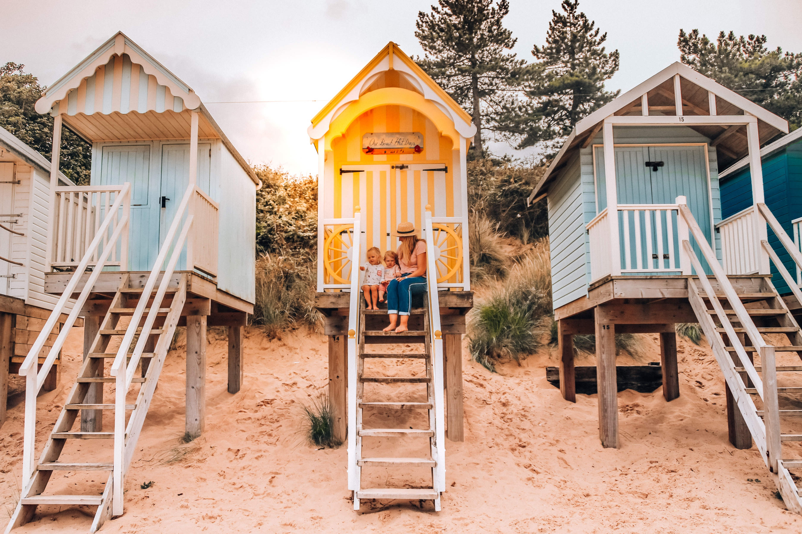
National Update
Rachel Gillis, Regional Development Lead, VisitEngland
Wells-next-the-Sea – VisitBritain / Ollie Lilvert

Slide 2








Our role
Drives growth from tourism across the nations and regions so local communities feel the benefits
Simplifying a regional structure for English tourism to grow sustainable local visitor economies
Industry development support via accredited destinations to drive sustainable & inclusive growth
Sells Britain internationally as a visitor destination
Delivers for Government & Taxpayers: supports people-to-people connections
Win business events, positioning Britain as a global convener, supporting priority sectors and seasonal spread
Notes:
Firstly – VisitBritan and VisitEngland – distinct but related roles
VisitBritain promotes Britain on the global stage — showcasing our culture, landscapes and experiences to key international markets and supporting the wider GREAT campaign.
At VisitEngland, we focus on strengthening the domestic visitor economy. We champion sustainable growth, deliver skills and business support, and work closely with destinations to raise quality, resilience, and accessibility.

Slide 3
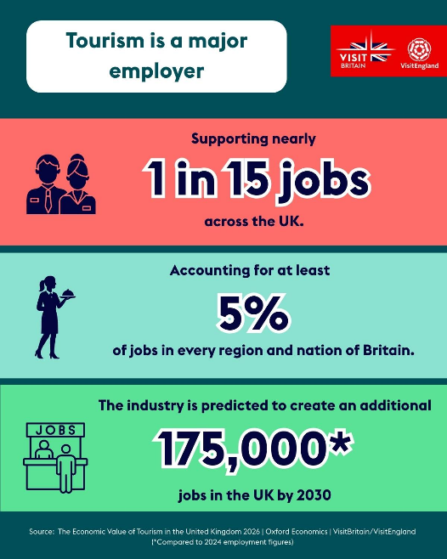
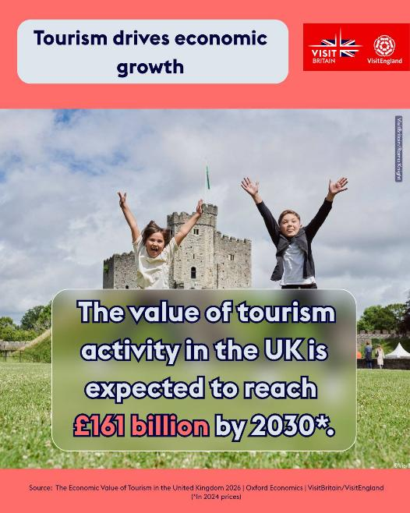
Economic Value of Tourism – new report
Value: Tourism is worth £147 billion annually to the UK, about 5 percent of the national economy.
Jobs: Tourism supports nearly one in every 15 jobs across the UK, about 2.4 million jobs. It accounts for at least 5% of jobs in every region and nation
of Britain.
Tax: Tourism generates £52 billion in tax revenues for the UK Government annually.
Forecast: Tourism is forecast to be worth £161 billion by 2030 (when adjusting for inflation), growing faster than the economy overall.
Economic Value of Tourism | VisitBritain.org
Notes:
In January we published the Economic Value of Tourism in the Uk report.
Showing tourism is worth £147 billion annually to the UK economy – that’s 5% of GDP
This landmark report provides a new and updated set of numbers of the value and importance of our sector – underscoring tourism importance as one of the UK’s most valuable industries.
Tourism accounts for 1 in 15 jobs and generated £52billion in tax revenues for the UK Government in 2024.
The value of total tourism activity in the UK is expected to reach £161 billion by 2030 in 2024 prices, growth of 9.3% when adjusted for inflation and ahead of the UK economy overall at 8.8%. Inbound tourism is forecast to drive much of this, with growth in value of 32%, £9.4 billion, between 2024 and 2030. The industry is predicted to create an additional 175,000 jobs in the UK by 2030.
We have results for England and the other nations and regions. In fact we were able to give the LVEP cut of this data to the team to help as you commission data for the LVEP.
Economic Value of Tourism | VisitBritain.org

Slide 4
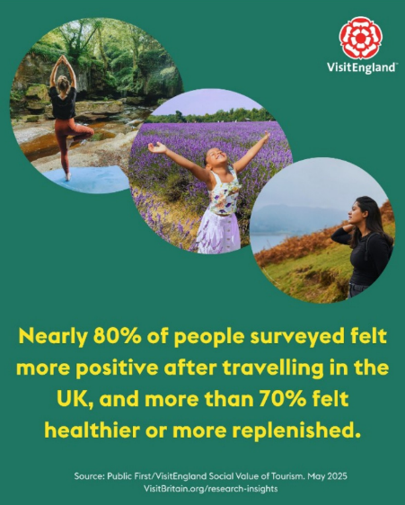
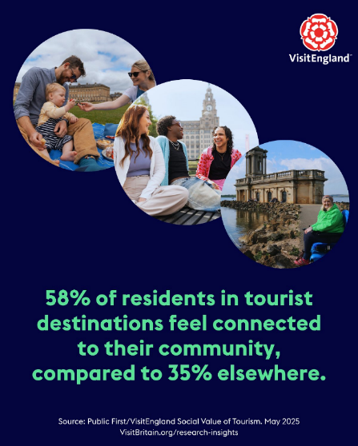
The Social Value of Tourism
The Social Value of Tourism | VisitBritain.org
Notes:
A sister report to the Economic Value Report published last year – exploring some of the social and community benefits of tourism, helping us develop a new narrative around the wider value of tourism, which is helping with the government’s strategy development.

Slide 5
Government perspective
“We had 41 million visitors before the pandemic, 38 million last year - I want to reach 50 million by 2030…..”
What’s next…:
New National Tourism Strategy underpinned by growth (expected early 2026)
Ministers are keen to drive regional growth and productivity focused on great destinations:
​Increasing visitor numbers sustainably with greater connectivity from existing and developing markets
Secure more events and innovative attractions that drive visitor interest across both business and leisure visitors and reduce seasonality
Improving guest satisfaction encouraging higher spend and repeat visits
Supporting sector businesses to thrive
VisitBritain / VisitEngland CSR 2026-29 settlement
Devolution and LGR – a changing landscape
Notes:
The Government has set a target of 50m international visitors a year by 2030,and will set out a national growth plan for the sector early in 2026. Ministers are keen to drive regional growth and productivity focused on great destinations:
Increasing visitor numbers sustainably with greater connectivity from existing and developing markets - getting more visitors staying for longer
Encouraging more Brits to ‘buy British’ to reduce the trade deficit and improve sustainability and accessibility
Secure more events and innovative attractions that drive visitor interest across both business and leisure visitors and reduce seasonality
Improving guest satisfaction encouraging higher spend and repeat visits through improved training, reduced vacancies, investment and regeneration
Supporting tourism businesses to thrive bringing footfall to high streets and venues, creating jobs, bringing the economically inactive back into work
VB / VE activity will align and so as yet is unconfirmed what our priorities and direction of travel will be

Slide 6
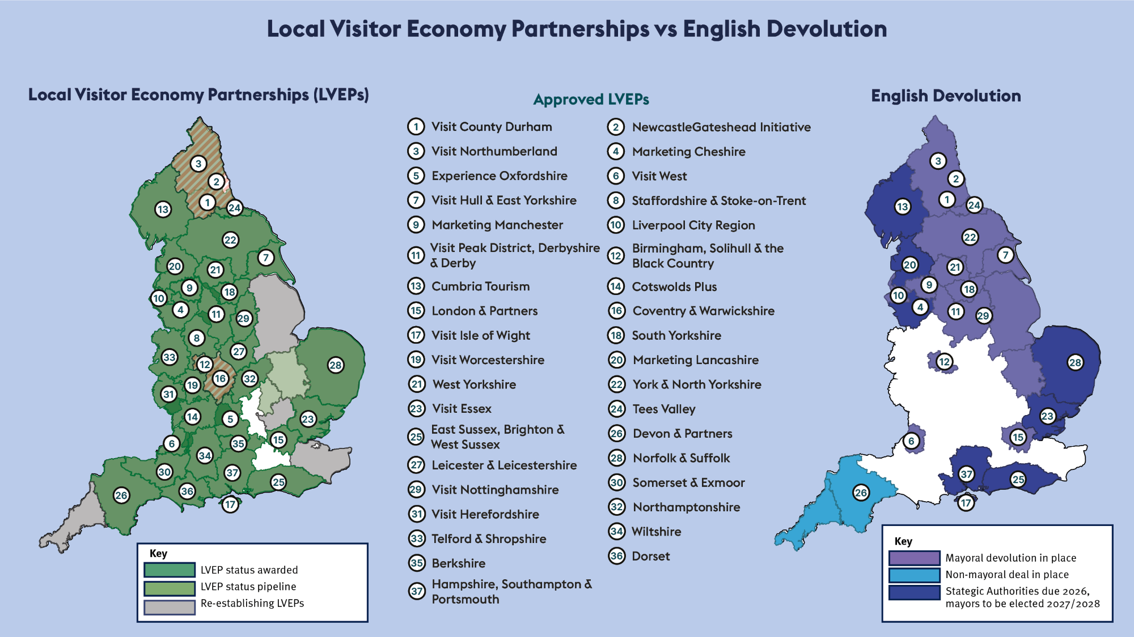
Current Mayoral Strategic Authority status
Notes:
We currently have 37 LVEPs, after unfortunately losing four last year. We are continuing to support these four areas to regain status. Likely that:
Cambridgeshire and Peterborough will submit an application imminently
Kent and Cornwall making good progress on reapplication, but no firm date yet
Hertfordshire and Lincolnshire making slower progress
Bedfordshire hoping to mobilise an approach on back of Universal planning decision..
We are mapping the relationships with CAs as this regional and devolution lens is increasingly important to government’s delivery of its strategy.

Slide 7
Future of the LVEP Programme
Plans for 2026
LVEP structure remains central to delivery for the visitor economy, for VB/VE and DCMS
Focus on product development (thematic, regenerative, inclusive, international-ready) – based on segmentation and product-market fit
Supporting LVEPs to become more sustainable and productive (AI and commercialisation)
Continued focus on research and insights
Domestic marketing
Coastal campaign pilot will guide future activity and domestic segmentation
Destination Organisations
Notes:
LVEPs remain central to DCMS and VE’s delivery of visitor economy growth
Building on our International-Ready work this year we look to evolve this further into product development (which will embed our thought leadership work in the two pillars of: accessible & inclusive and regenerative tourism). We’ll make use of a new segmentation work and feed learning from international and domestic campaigns into new product development.
We know we need to continue to support LVEPs in their own survival. Developing AI skills and supporting commercialisation are our two prongs of support here.
Our AI Impact Programme, developed with the Digital Tourism Think Tank, is designed specifically for the LVEP landscape . It uses AI as a hands‑on, problem‑solving tool—building confidence and capability while enabling teams to embed AI into day‑to‑day work for immediate, tangible organisational impact.

Slide 8
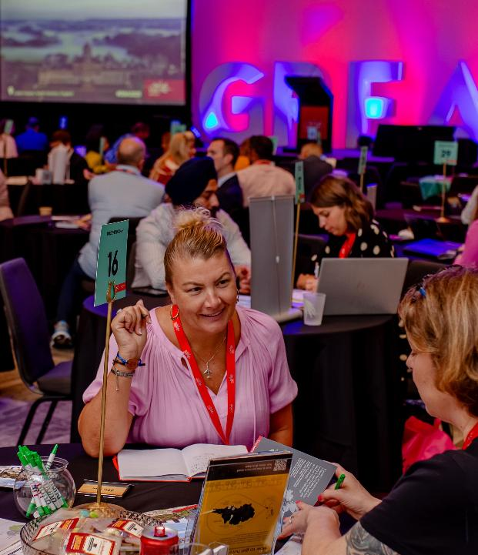
Travel Trade Programme
Events
Benelux LVEP event 11th Feb
ITB 2026: 3rd-5th March
2026/27
Support LVEPs and their travel trade plan development
Work through LVEPs to engage and upskill businesses to work with the trade
Support activity and platforms to get LVEP product into DMC and operator programmes
Notes:
As part of VisitEngland's LVEP International-Ready Programme we have been able to offer opportunities for LVEPs to meet international buyers over the last 6 weeks - at a dedicated LVEP event in Amsterdam, and through an enhanced VisitEngland presence at ITB this week.
We recognise that not all LVEPs have the same level of experience when it comes to working with the travel trade and we also recognise that developing relationships with the trade, and seeing results from trade facing activity, takes time.
It is our intention that these activities will provide a template for us to offer similar opportunities for you in years to come. It has been great to see so many LVEPs sign up to the events coming up and focus more on this area
Next FY we will continue to support LVEPs to deliver travel trade plans and will work through LVEPS to reach out to their businesses to underline the value of the travel trade . In fact RT has been speaking with Andrew about this and we are here to continue to support you work up your plan in coming weeks.

Slide 9
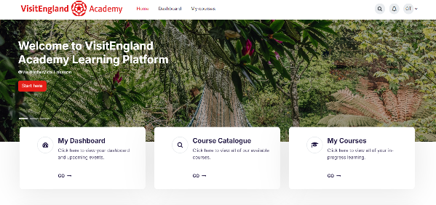

LVEP Training and Toolkits
VisitEngland Academy
Grant Funding and Bid Writing Toolkits
E-Commerce and Digital Marketing e-learning courses
Travel Trade Engagement content
Business Events toolkit and training
Welcoming LGBTQIA++ Customers
Taking England’s Wine Tourism to the World
Notes:
​
Much of the training we have developed sits as evergreen learning resources on our VisitEngland Academy.
Early examples being our funding & bid writing tool and e-commerce. Early examples of areas where LVEPs told us they needed help.
Here some of the training is open to businesses and some open to LVEPs exclusively.
Its is constantly growing in content.
We regularly promote new courses through our news letter, and include registration details.

Slide 10
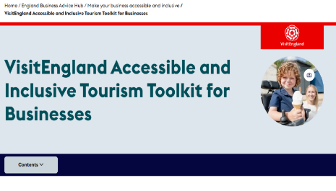
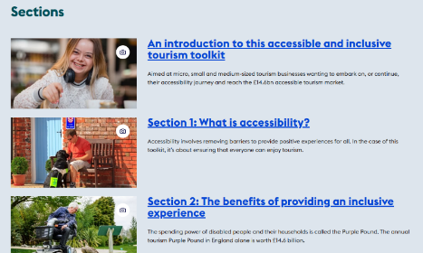

Accessibility and Inclusion
VisitEngland Accessible and Inclusive Tourism Toolkit for Businesses
  Holistic guidance with real-life case studies
  Downloadable business-specific actionable checklists and top tips
  Technical guidance
AccessAble initiative
  20+ LVEPs partnering with AccessAble
LVEP Accessibility Support Programme
  Support LVEPs through the Toolkit and Kick-Start Programme
  In the process of establishing the LVEP Accessibility & Inclusion Forum
Notes:
One of our core pillars of work – that will continue to run through DCMS’s Visitor Economy Strategy and our work is accessibility and inclusion.
Central to our support is the Accessibility & Inclusive Tourism Toolkit – a comprehensive on-line resources with entry level, foundation and enhanced levels.
Our partnership with AccessAble this last year has enabled over 20 LVEPs to partner with them and gain access to their access guide tool, assessments, support and discounted guides for their businesses.
We’ll continue to evolve this work, with LVEPs through the new LVEP A&I Forum we are establishing at the moment (likely to first meet during April).

Slide 11
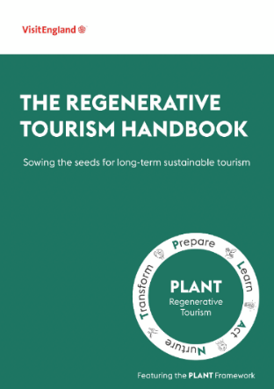
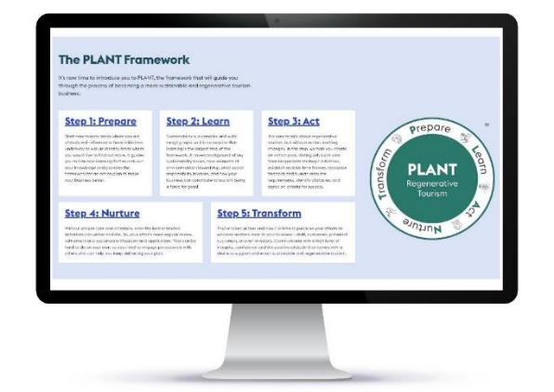
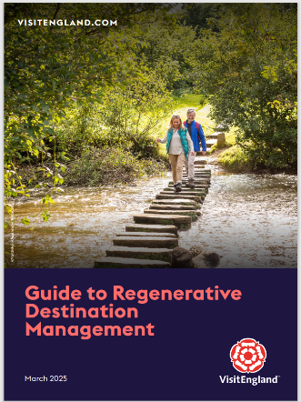
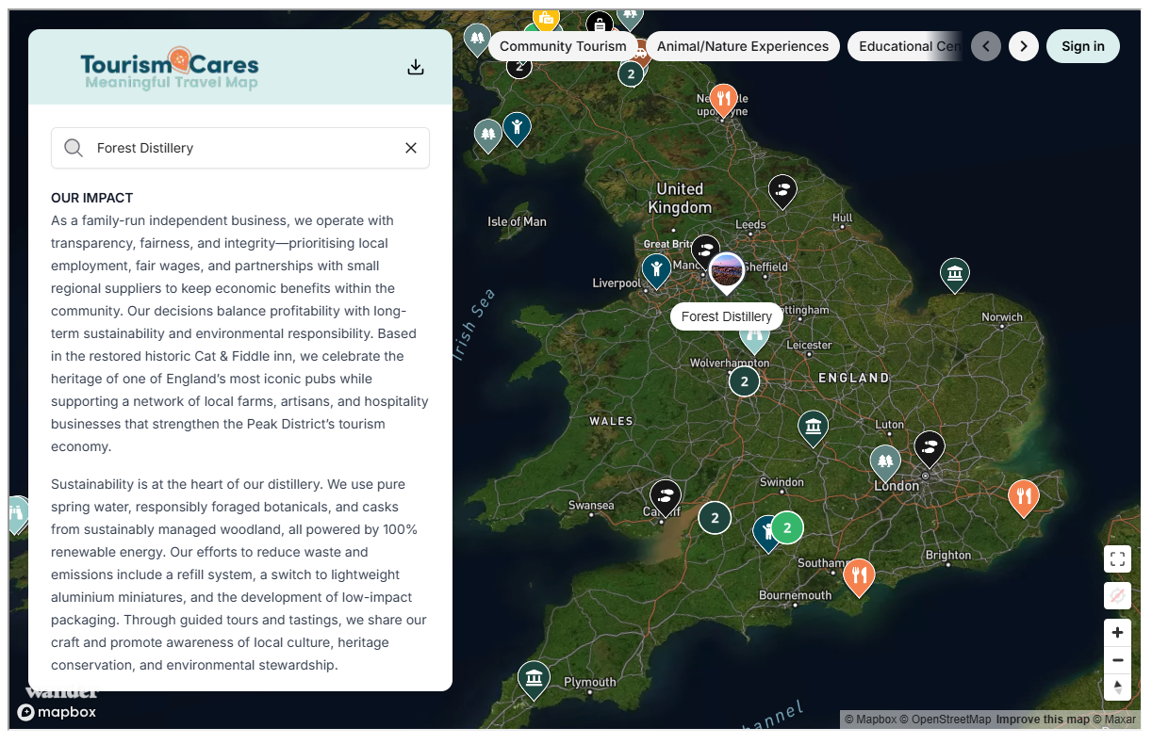

Regenerative Tourism
Notes:
The second of our core pillars of work – that will continue to run through DCMS’s Visitor Economy Strategy and our work is regenerative tourism
With this we are aiming to move beyond sustainable tourism to make an even bigger and more positive impact through a regenerative tourism approach.
Last s year we launched the Regenerative Tourism Handbook for businesses to help adopt regenerative tourism principles and adopt the right kind of growth that actively contributes to making the place better for both residents, businesses and visitors
This supports businesses on their journey to sustainability and regenerative tourism, we produced The Regenerative Tourism Guide for businesses. The PLANT framework will help businesses to either get started on their journey or to build on the work they are already doing.
Also produced the Guide to Regenerative Destination Management – aimed at LVEPs.
Since then we have commissioned case studies of businesses who exemplify these principles, just commissioning six more.
We also have a storey telling and communication workshop.
Working with our US VB team we developed the travel map for conscious travellers – developed with Tourism Cares. Launched last year and growing in numbers.

Slide 12
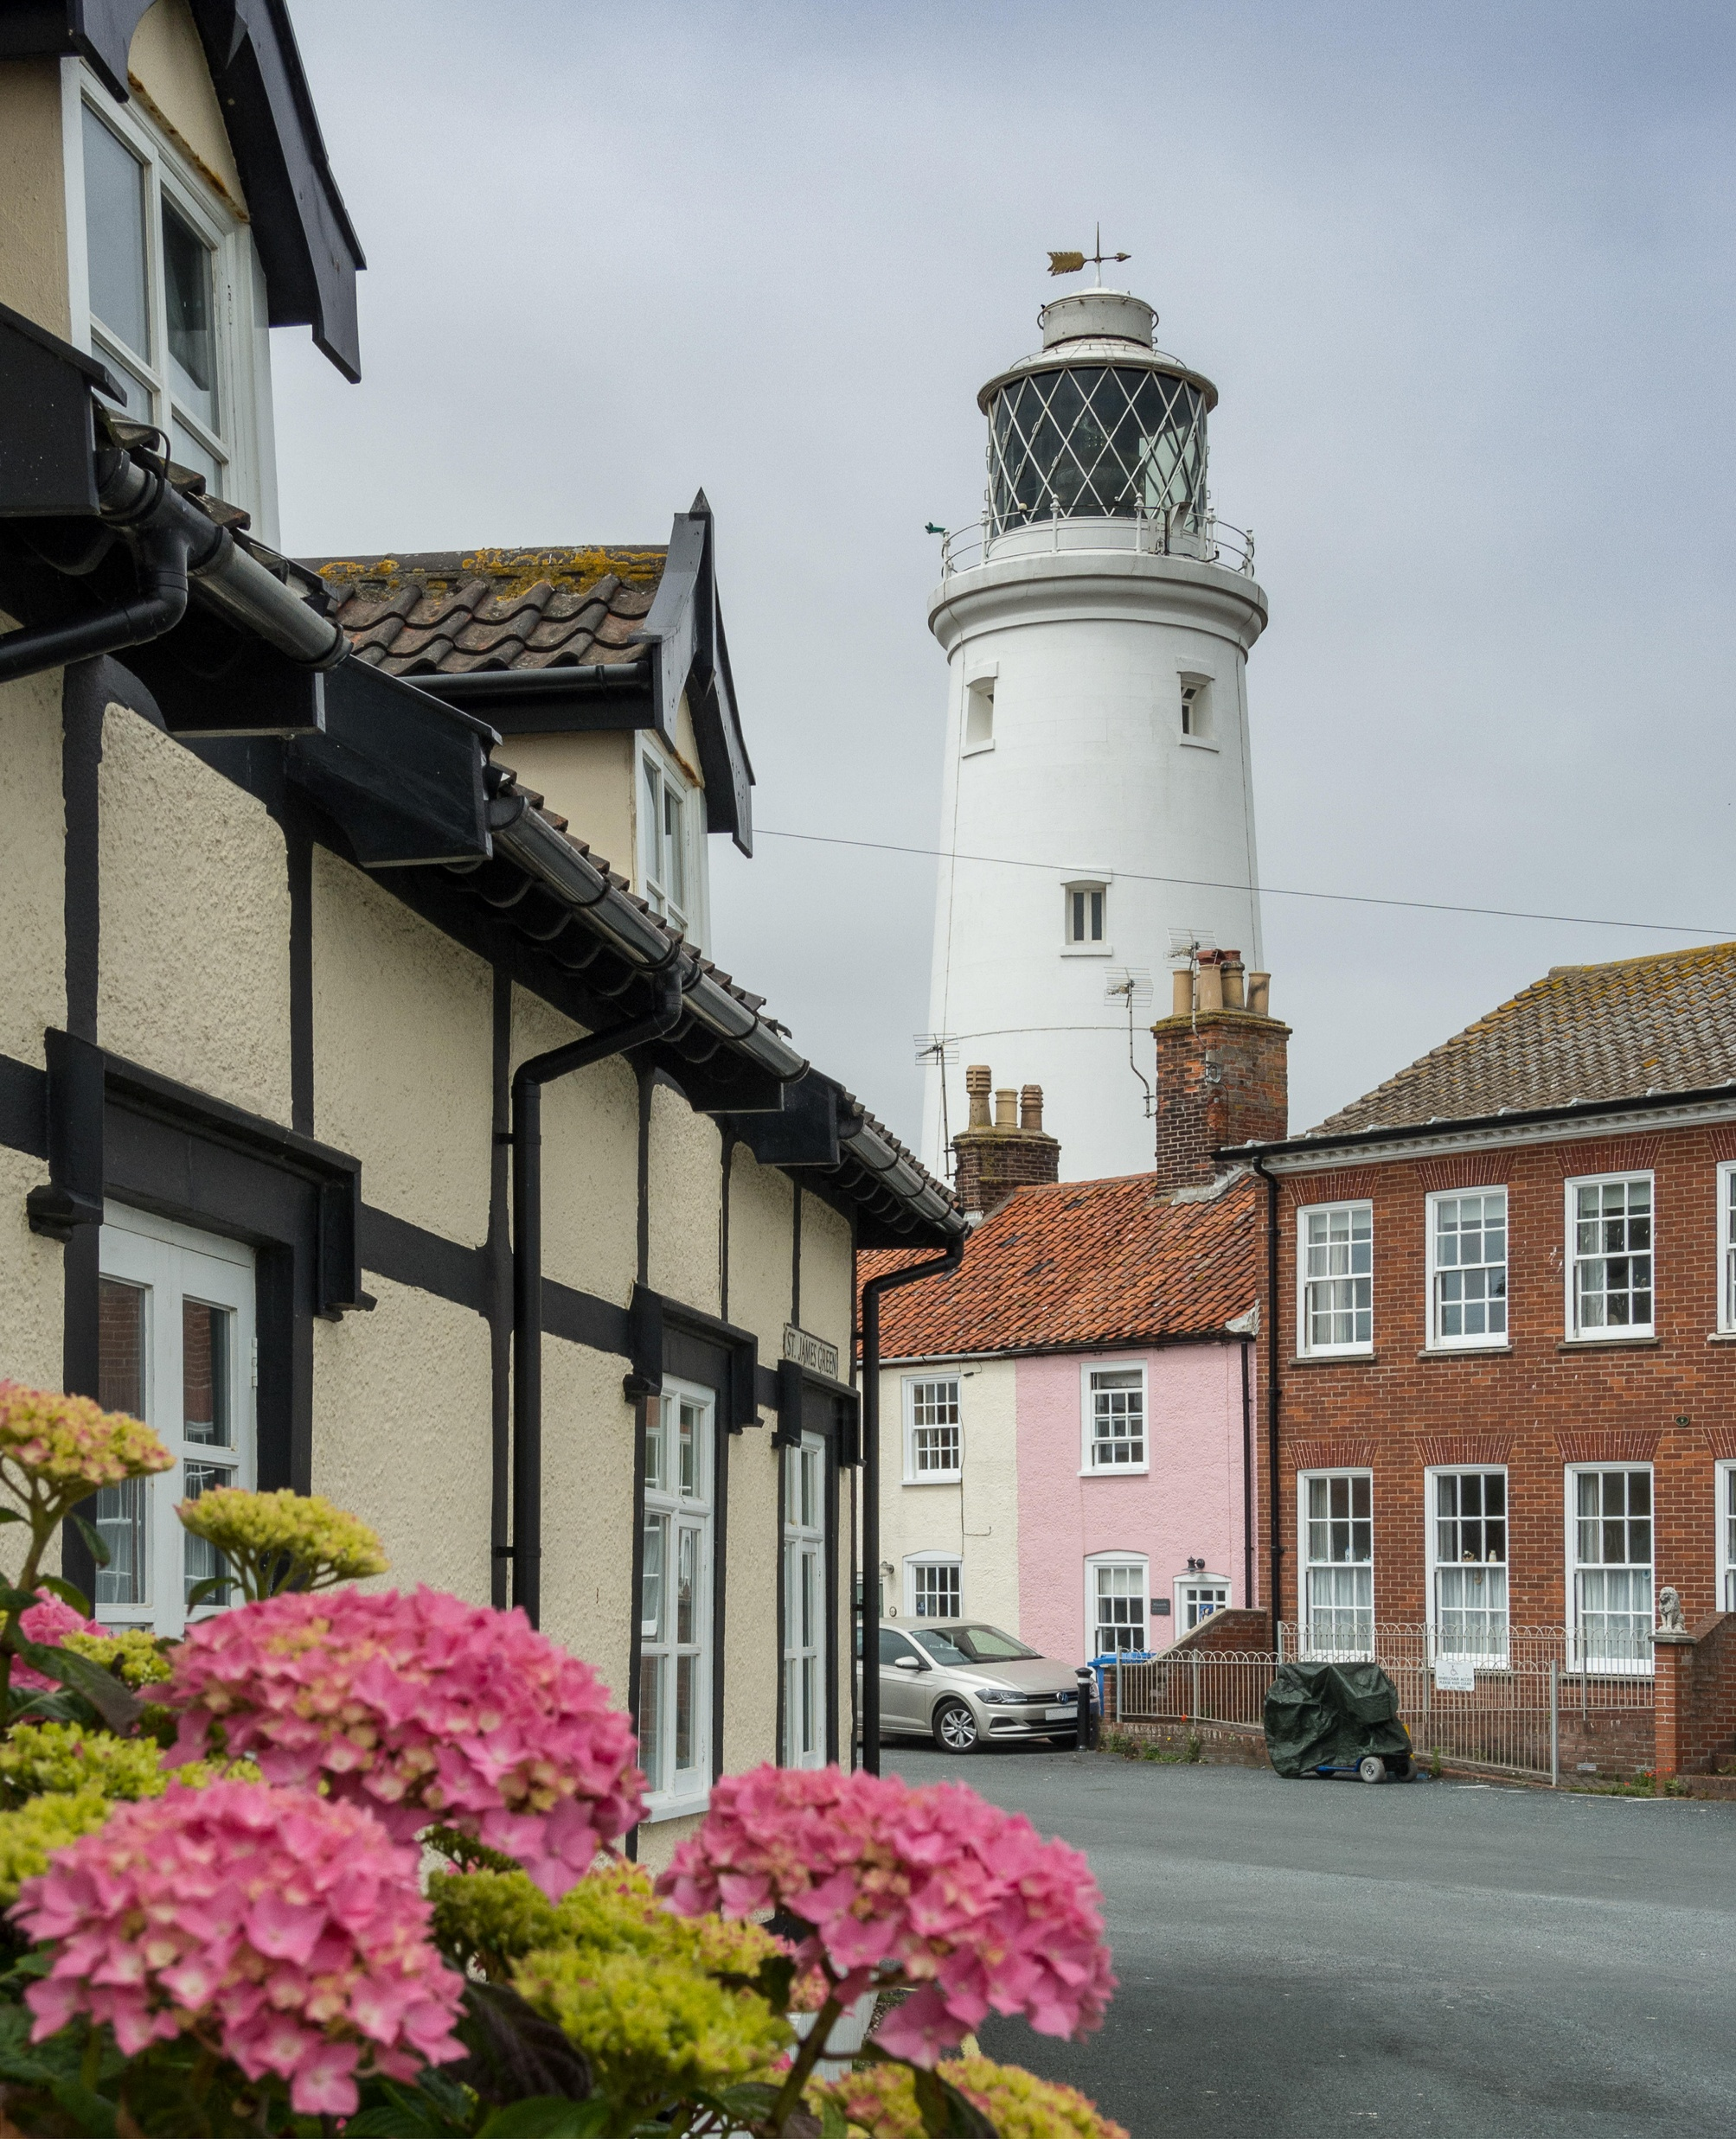
Data, Research and Evaluation Workgroup – upcoming next 6 months
Economic impact report – LVEP level analysis – March
Domestic data for Visa spend – LVEP level - March
Domestic market segmentation - April
Mosaic International product and market research - March
Accommodation stock audit – March
Annual Attractions survey new approach - April
LVEP KPI directory - April
Re-brief hotel occupancy - July
Southwold - Alamy / LankowskiLankowsky / Alamy
Notes:
Our LVEP Research & Data group continue to co-produce our research and data programme
.
the next research session for LVEPs is 22nd April

Slide 13
VisitBritain Priority: Rebuilding Inbound Value
Position Britain as a dynamic, diverse, sustainable and inclusive destination, prioritising regional and seasonal dispersal.
Connect & Distribute
Supporting destinations international strategies - linking buyers and suppliers through familiarisation visits and trade shows
Inspire
Innovative marketing campaigns – Starring Great Britain, phase 2
Convert
Working with Airports, airlines and booking agents i.e. Tripadvisor
Notes:
Looking to VisitBritain and thinking internationally
Tourism is an extremely competitive global industry - we want to make sure that visitors choose Britain for the next trip, staying longer and exploring further – discovering more of what Britain has to offer.
Our role is to position Britain as a dynamic, diverse, sustainable and inclusive destination, prioritising regional and seasonal dispersal and improved productivity.
We do this by:
Linking buyers and suppliers – through fam visits, missions and events
Inspiring visitors – through our campaigns and social media
Working with commercial partners – such as BA, Trip Advisor….

Slide 14

Starring GREAT Britain
Objectives:
Drive increased consideration to visit the nations and regions of Great Britain resulting in incremental spend & visits to the economy
Demonstrate a welcoming, dynamic, and diverse Britain to drive urgency to visit
Target audience and markets:
'Experience Seekers' – paid campaign in US, France, Germany, Australia, Gulf Co-operation Council (GCC) countries
Owned, earned & trade channels in all global VisitBritain markets
Supported by secondary KPIs, including (but not limited to):
  Paid media metrics
  Earned media metrics
  Owned channel metrics
Increasing consideration
Driving urgency
Notes:
Our currently major campaign, entering its second year is Starring Great Britain.
Objectives
Target markets
Paid, owned and earned.

Slide 15

Working together for Suffolk & Norfolk
A clear strategic link from the local to the national level – a voice for the wider Suffolk & Norfolk region at national strategy, visitor levy consultations etc
National network of peer-support and best-practice sharing opportunities – LVEP conference Jan 26, commercial models, business support workshops
Support from Regional Development Lead – Growth plan development & ongoing support in identifying opportunities
Central thought leadership, expertise, support and tools – Accessibility training programme & Access guides, AI support programme (Jan 26), International-ready programme
Enhanced destination insights and intelligence – Social value of tourism report, Economic value report, business surveys template, new data sources i.e. STR, Visa spend
Opportunity to benefit from our marketing and travel trade activity – VE PR event (March 26), VB content webinars & submissions to themes incl. #StarringGreatBritain, USA trade webinar opportunities, Fam visits programme, Year of the Normans 27 etc
Access to any grant funding opportunities
16
Notes:
This has very much been a foundational year – from your DMP – building new websites, developing the NaturAlly brand and launching the Brecks Regenerative Tourism Project.

Slide 16
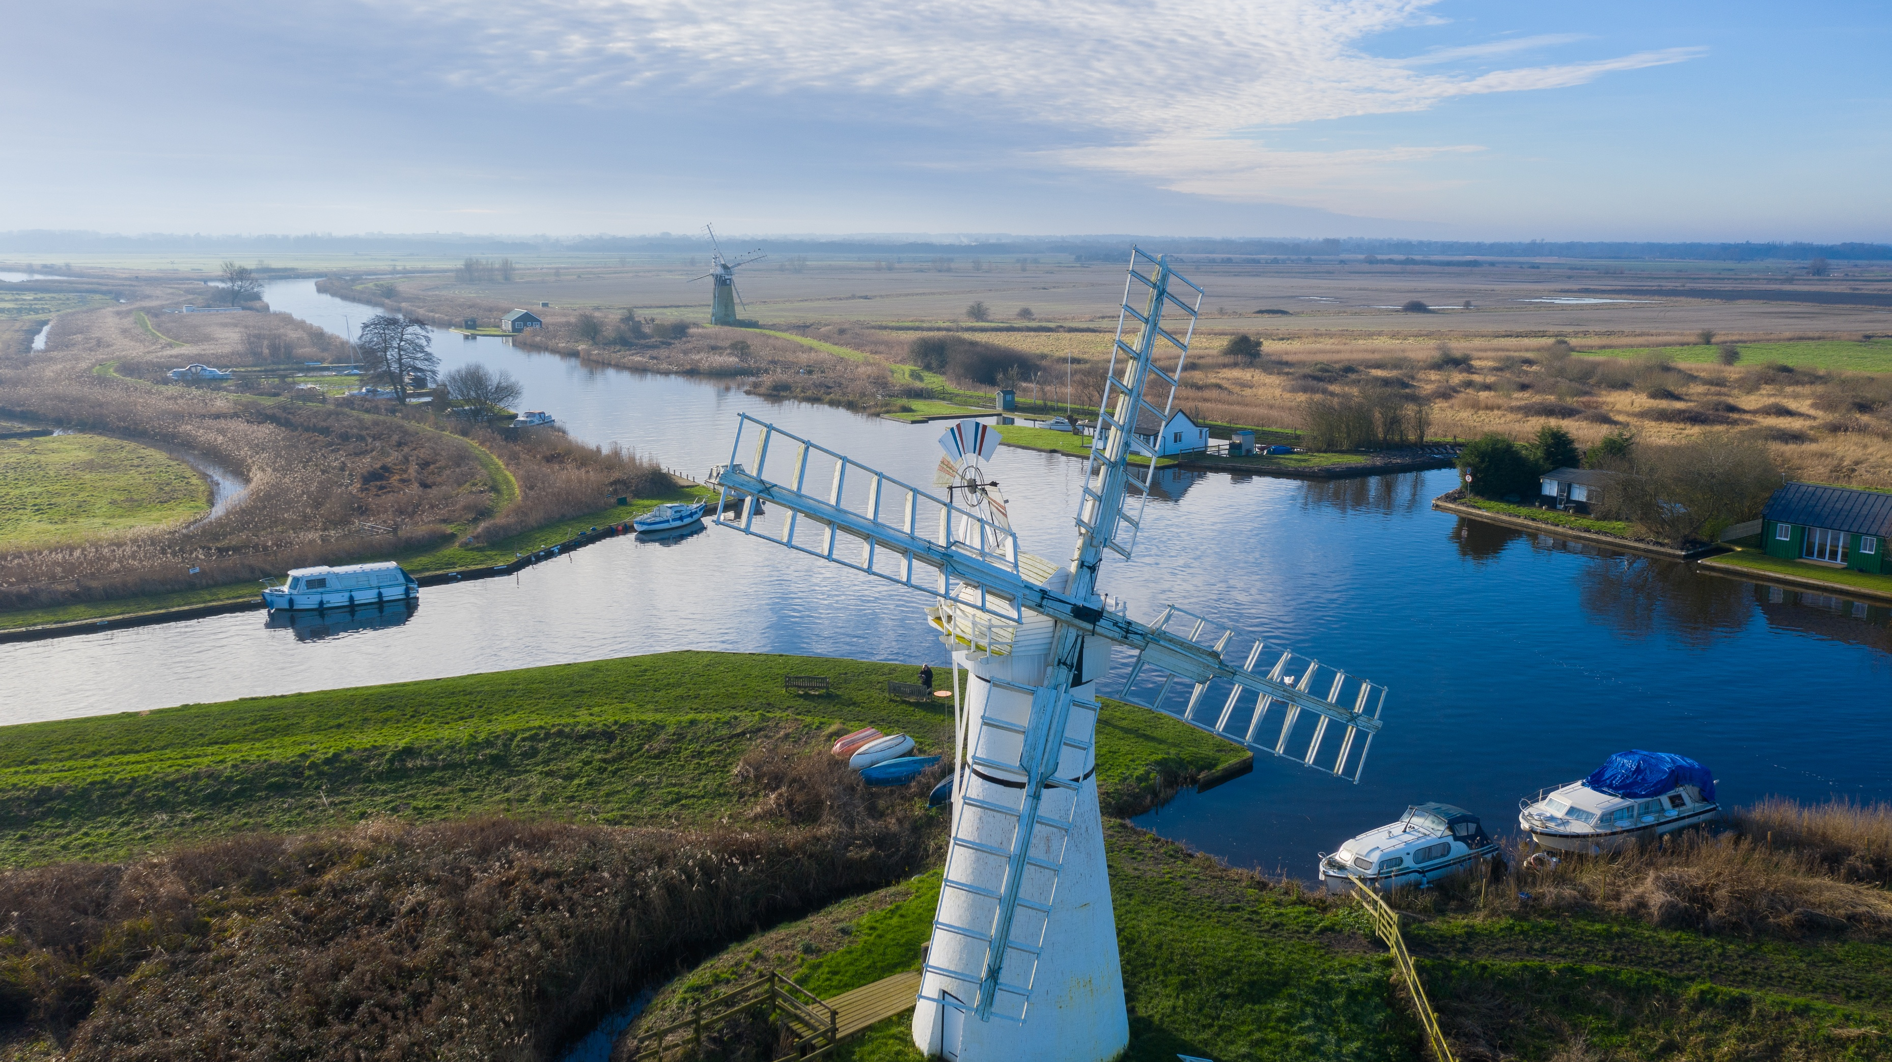
Thank you! Questions?

