Slide 1
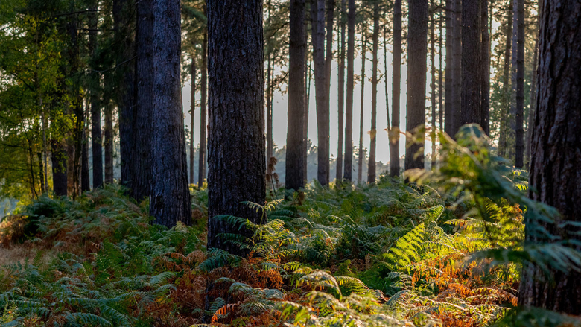
The Brecks
A plan for 2026

Slide 2
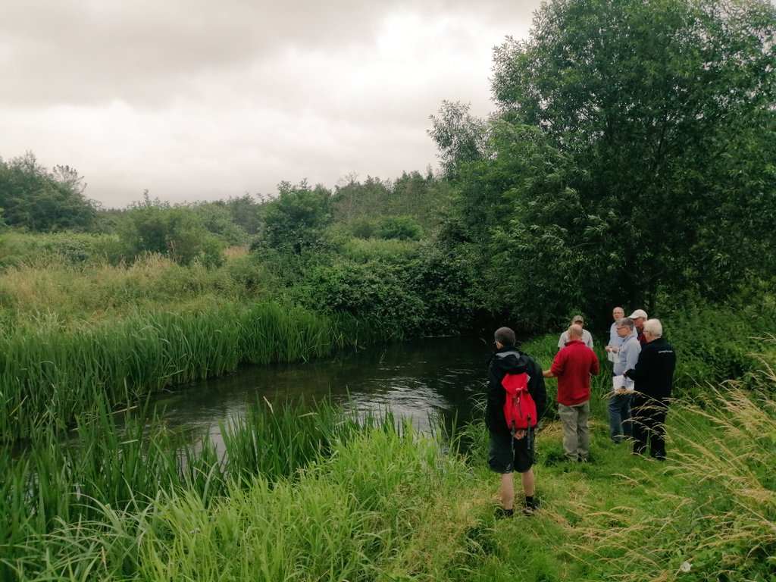
Developing the Brecks Regenerative Tourism Framework
A stakeholder-led, measurable approach, co-designed with local partners

Slide 3
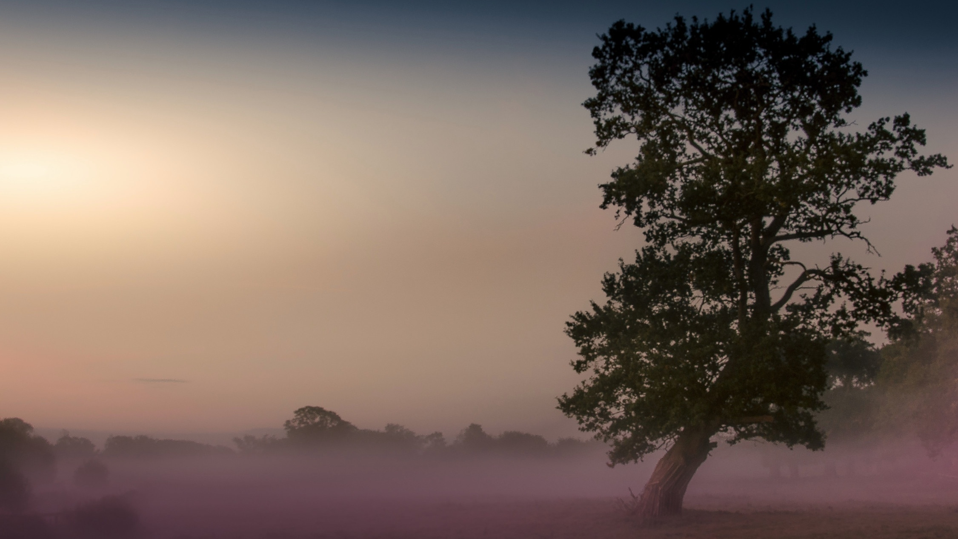
Why the Brecks should be the UK’s first
Regenerative Tourism National Character area
Regeneration in the Brecks isn’t a frame-work, it’s a way of life.
This place has always been shaped by a relationship between land and people.
Our aim is to showcase what already works, strengthen it,
and make it easier for visitors to support it.

Slide 4
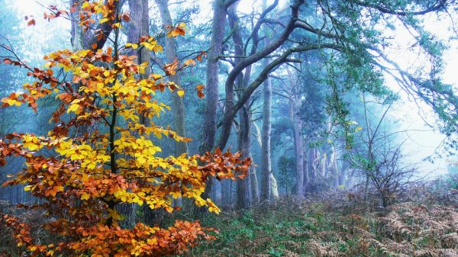
Four guiding principles
Working with
the land’s offering
Keep value local
Invite visitors to give back
Build year-round resilience

Slide 5
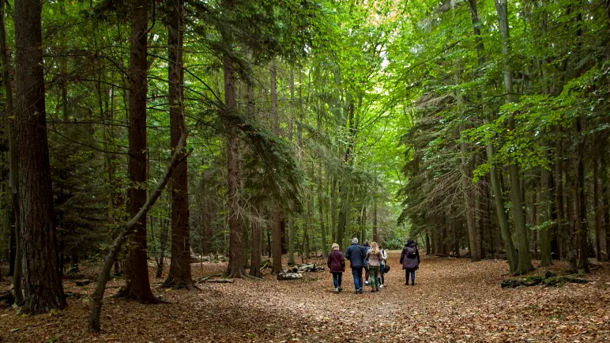
What’s been achieved in 2025?
Mission statement
10- point plan
4 Working Group
3 LVEP Board Meetings
130+
organisations on Brecks NCA database
120+
businesses mapped on Google Maps
University of Greenwich Academic partnership
50+
In-depth businesses engagement, incl. collab with BFWN & Brecks Partnership
20+
Early adopters

Slide 6

What’s Happening Now?
Regenerative Tourism Framework development

Slide 7
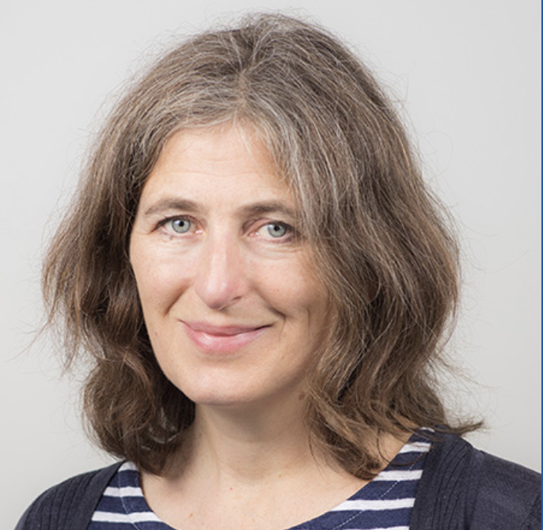




Framework development
Why have we partnered with
the University of Greenwich?
A well-respected academic partner ensures that a regenerative tourism framework is:
Credible (evidence-based and rigorous)
Ethical (community-centred and transparent)
Adoptable (policy-relevant and scalable)
Durable (able to evolve over time)
Without such a partner, regenerative tourism risks becoming another buzzword, rather than a meaningful transformation of how tourism contributes to the health of places and people.
Dr Nikki McCleod
Principal Lecturer in Tourism
Dr Wenjie Cai
Associate Professor in Tourism
Dr Isabella Ye
Senior Lecturer in Tourism
Dr Hai Nguyen
Associate Professor in Tourism

Slide 8
UoG Framework co-created with Brecks early adopters
Wyken Vineyard
Elveden Estate
Forestry England / Thetford Forest
Euston Estate
Wendling Beck
The Food Museum
Bush Adventures / Experiences
Anglo-Saxon Village
West Lexham
Westacre Estate
National Trust / Oxburgh Estate
11. The Granary (Susie Emmett)
12. Suffolk Wildlife Trust
13. Norfolk Wildlife Trust
RSPB
15. The English Whisky Company
16. Explore 4x4
17. Thetford Garden Centre
18. Strattons
19. Mary Kemp
20. Brecks Landscape Partnership

Slide 9
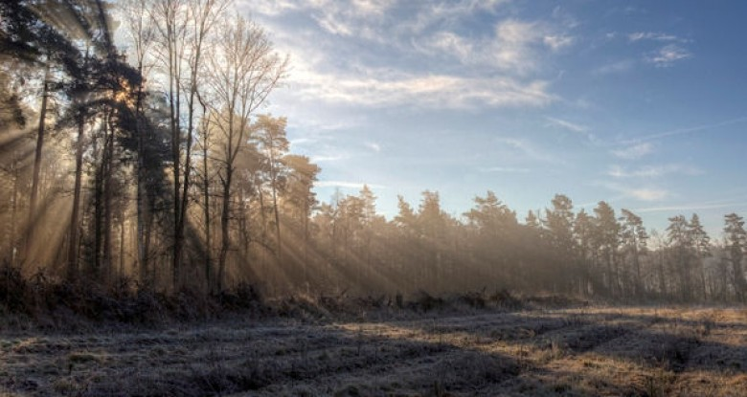



Opportunities to get involved
Survey snapshot
Gathering insights into operational practices, environmental initiatives, & tourism business priorities
Co-creation workshops
2 workshops designed to ensure that strategies are practical, locally relevant, & genuinely impactful
Ambassador stories
Development of deep, professionally crafted, case studies with a select number of businesses to bring the stories of the Brecks to life

Slide 10
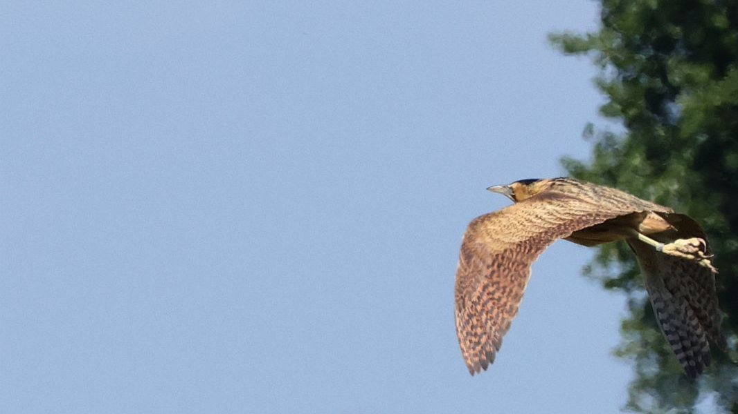
Join us to build a stronger Brecks
Attract conscious visitors who stay longer and spend more
Strengthen your story with marketing support
Learn from peers & join an eco-tourism network
National Recognition and exposure as part of a flagship destination programme
Co-create a Regenerative Framework that will put the Brecks on the map

Slide 11
Gain early adopter benefits for your business
Communications through newsletters, webinars and face to face events (B2B & B2C)
Naturally Placemaking Branding and launch campaign: including The Brecks as a new destination
Regenerative Tourism Framework hosted centrally with signposting to early adopters and ambassadors’ websites
University of Greenwich promotion via conferences, papers and reports
Engagement through new Visit Norfolk, Visit Suffolk, Visit East of England, B2B and Travel Trade sites
Engagement through new Visit Norfolk, Visit Suffolk, Visit East of England, B2B and Travel Trade sites
Themed travel itineraries to encourage staying visits
Featured on website blogs
Case study development
Featured in newsletters sent to 100,000 database
Marketing & PR opportunities with Visit England & Visit Britain
Potential inclusion on press trips, familiarisation trips, films & promotional activity
Dedicated sign-in to digital systems to enable real-time updates to your content
Social media exposure
Exclusive access to LVEP training webinars to help boost your business.
Exclusive access to Visit England & Visit Britain research & and insights.
Training resources for businesses.

Slide 12
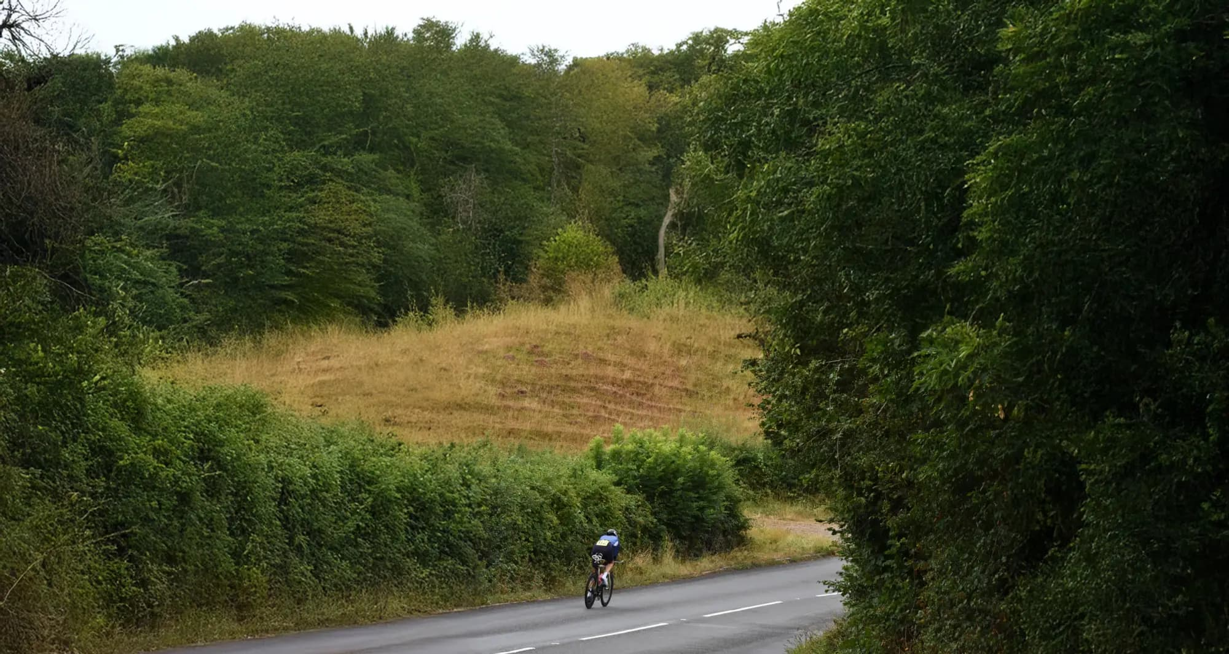

Framework process
Map what’s happening
Co-design the approach
Turn it into action
Understand sustainable/regenerative work already being done & challenges faced
Baseline Survey:
Jan to Feb 2026
Build a Brecks-specific regenerative model, realistic for adaption & adoption in other areas
Workshops:
Feb to April 2026
Create a shared pledge, practical tools & stories visitors can act on
Interview & Case Studies:
May to September 2026

Slide 13
Phase 1: Baseline Survey Preliminary Stats
31 responses out of 90, 34% response rate
82.8% consider themselves within the Brecklands National Character Area.
  41.4% family-owned and operated
  13.8% SMEs
  13.8% charities
  Small numbers of farmers and landowners
Mostly micro and small businesses with fewer than 10 or fewer than 50 employees (48.3% and 41.4% respondents, respectively)
Most businesses consider themselves hosts, activity or experience providers, or have a mixed role.
  75.9% offer services all year-round
  69% serve day visitors
  34.5% welcome more than 5000 guests/visitors annually

Slide 14
Snapshot: Businesses’ Expectations
Top five most valuable benefits of regenerative tourism for their businesses include:
  (1) Improved guest/visitor attraction, satisfaction, and loyalty;
  (2) New partnerships and networks;
  (3) More customers;
  (4) Enhanced marketing effectiveness and business reputation and;
  (5) Improved environmental regeneration (e.g. restoration of habitats, increased biodiversity, reduced pollution, improved soil and water health).
Top five most valuable benefits of regenerative tourism for the Brecks include:
  Improved environmental regeneration (e.g., restoration of habitats, increased biodiversity, reduced pollution, improved soil and water health);
  Improved cultural regeneration (e.g., revitalisation of local traditions, crafts, stronger cultural identity, intergenerational knowledge transfer);
  Enhanced visitor experience, satisfaction and wellbeing;
  Increased long-term local economic benefits and;
  Strengthened destination image and long-term resilience.

Slide 15
Snapshot: Current Sustainable / Regen. Tourism Practices
24.1% reported that they have a formal policy/strategy for both sustainability and regenerative tourism
51.7% reported that while they have no formal policy/strategy, informal actions are available
61% of their sustainability and regenerative initiatives focus on a balanced approach between harm reduction and improvement.

Slide 16
Snapshot: Barriers to Regenerative Tourism
Top five barriers:
Lack of financial resources or access to funding;
Limited staff time or capacity to work on new initiatives;
Lack of knowledge or expertise on regenerative tourism,
Difficulty measuring or evidencing outcomes (e.g., nature, community wellbeing, local economic benefit) and
Lack of support from local authorities or destination organisations.
Financial and human resources emerge as the most critical concerns, with more than 50% of respondents identifying them as key barriers.
Most businesses agreed that all the barriers would prevent them from engaging with regenerative tourism to some extent, and only 17.9% indicated that the barriers would not prevent their engagement.

Slide 17
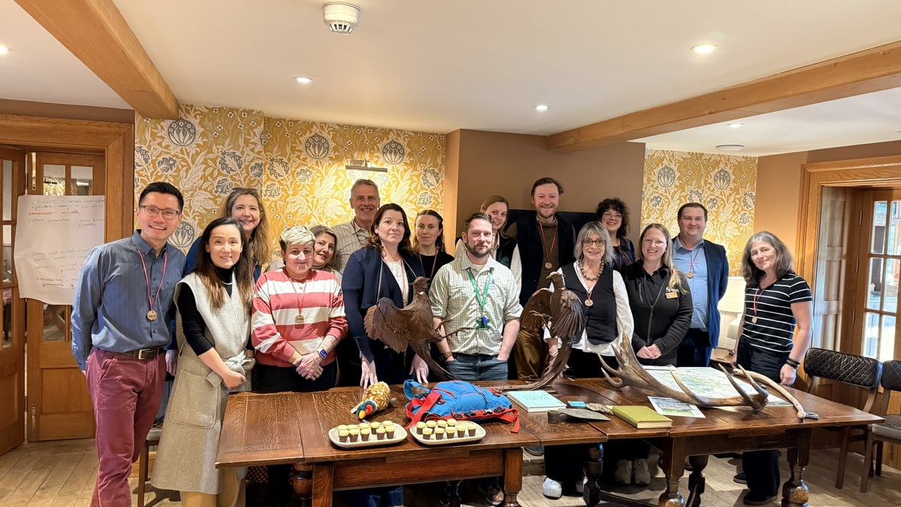
Phase 2: Workshop 1 at Elveden Estate – 5 March 2026

Slide 18
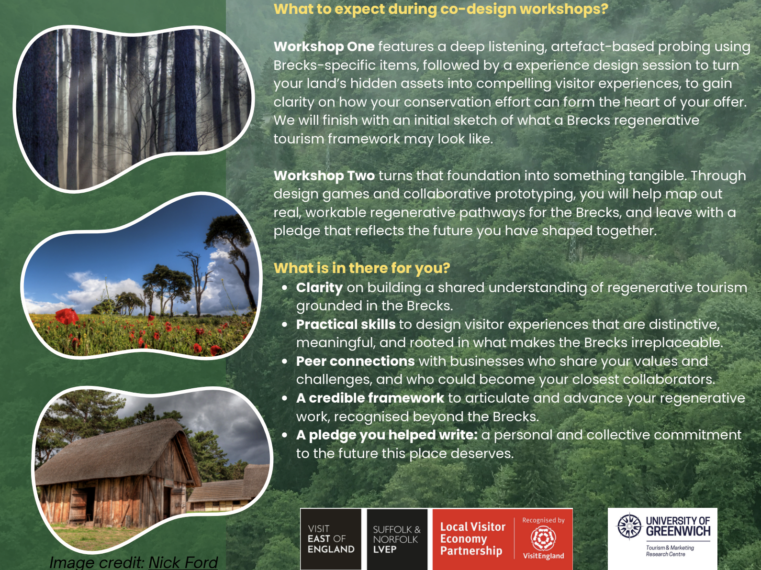
Phase 2: Workshop 2 at The English Distillery– 17 March 2026

Slide 19
What’s next?
Brecks destination marketing & comms foundations
Ongoing Stakeholder engagement & syndication
Regenerative Tourism Framework development
External stakeholder engagement
PR Planning
Launch & activation

Slide 20
WIP timings
 | Jan | Feb | Mar | Apr | May | June | July | August | September
Brecks Team | - Early adopter stakeholders confirmed - Engagement phase begins, bringing the Brecks on the journey - Stakeholder and moment mapping (Influence, & Trade) | Identify Brecks destination marketing requirements - Development of assets commences - PR & external stakeholder planning commences | - Development of assets ongoing - Stakeholder engagement & syndication ongoing - External stakeholder engagement & PR planning ongoing |  |  |  |  |  | Public launch: The Brecks as the UK's first regenerative tourism national character area - Inclusion of Brecks in VEE shoulder season activation
Uni Team | Business-facing deck development - Baseline survey designed & ready - Desktop research & exemplar mapping - Workshop development Survey live | - Survey live - Co-design lab workshops with early adopters | - - Co-design lab workshops with early adopters - Draft regenerative tourism framework | - Interviews & case study development - Early findings presented at regenerative tourism academic conference | Interviews | - Early findings presented at Netherlands Int academic conference |  | -Final outputs: report, framework, case studies
Key Dates |  | UK Inbound Annual Convention | Birmingham Tourism & Travel Show ITB | Presentation at Association for Tourism in Higher Education Southern Tourism Academic Network launch on 15th April |  | Presentation at International Adventure Conference on 10-13 June. |  | -Journal articles ongoing | 5th September – Digital Detox Day

Slide 21
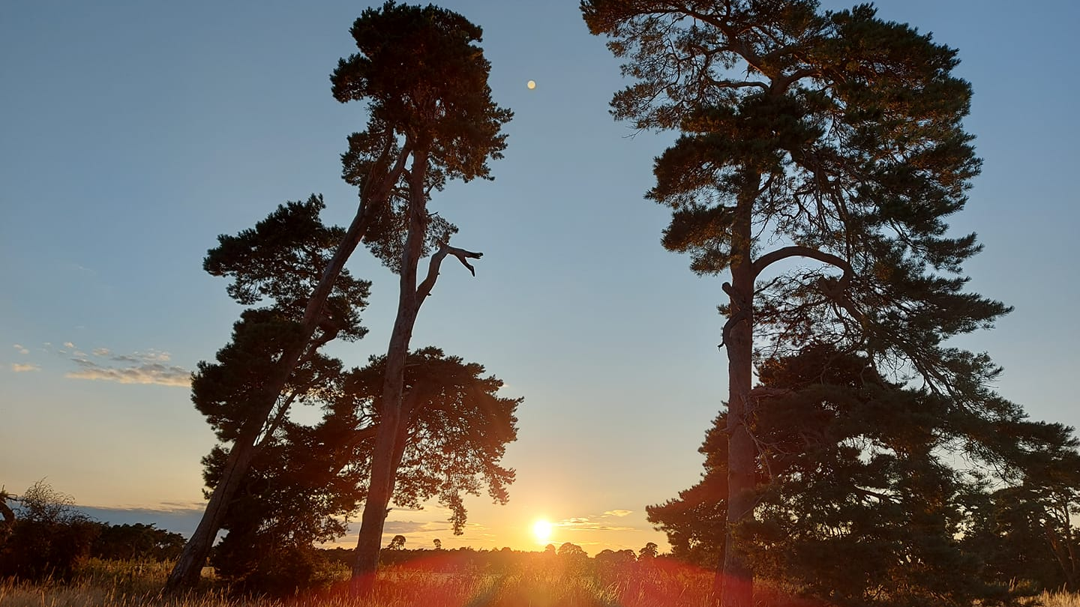
Thank you

